Slide 1
Team 4-Technostacks
E-Learning platform
UI UX Design
Last Updates:29-09-2023
Authors:-
Arayan Jakhar 21BCS11851
Anupam 21BCS3710
Isha Limbasiya 21CBS1066
Dhruv 21BCS11322
Sanskar Gautam 21BCS4553
Dharmesh Gidwani 21BCS10745

Slide 2
Student Side Website

Slide 3


Slide 4
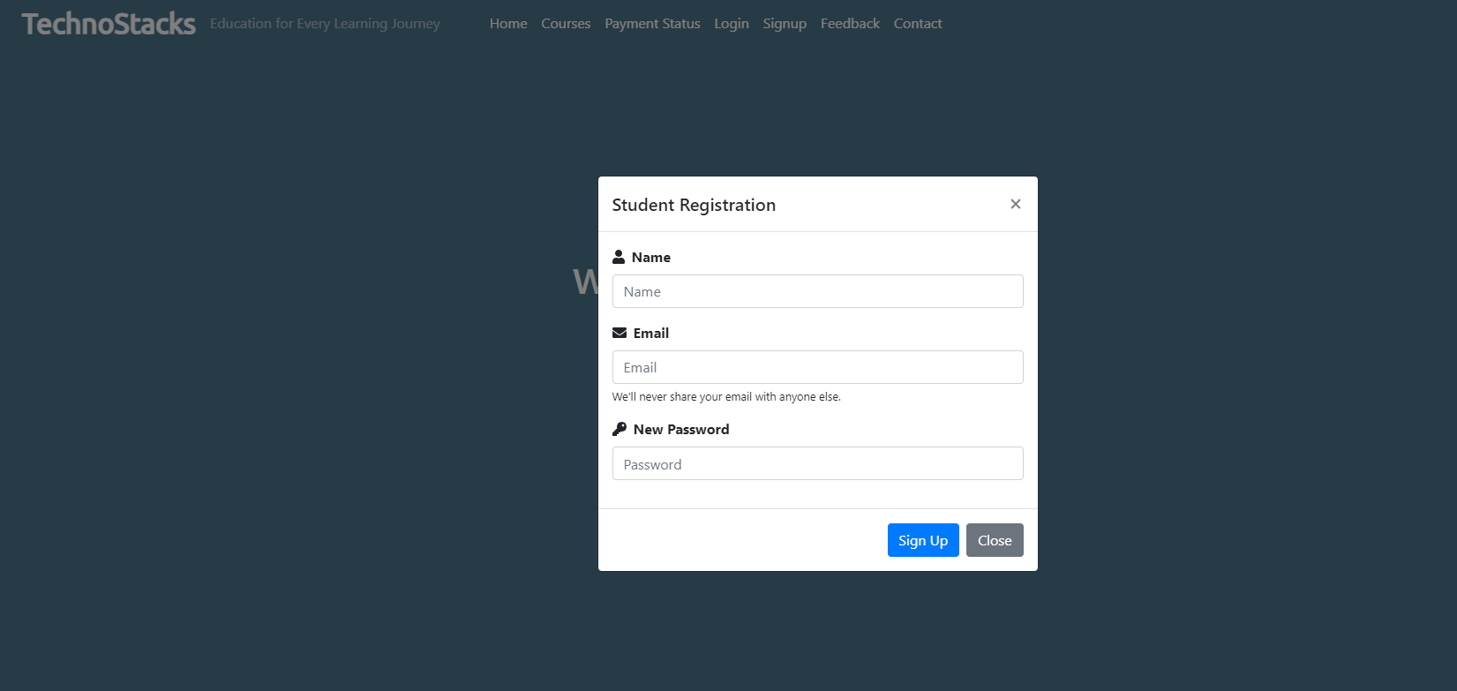

Slide 5
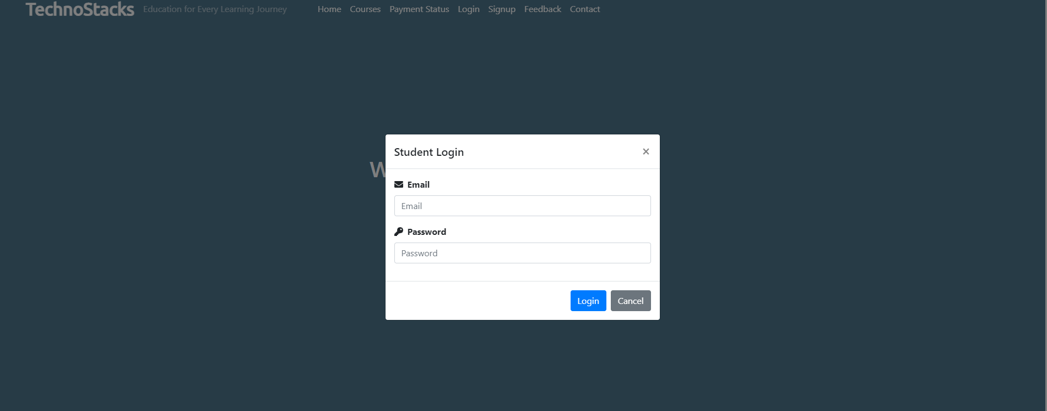

Slide 6
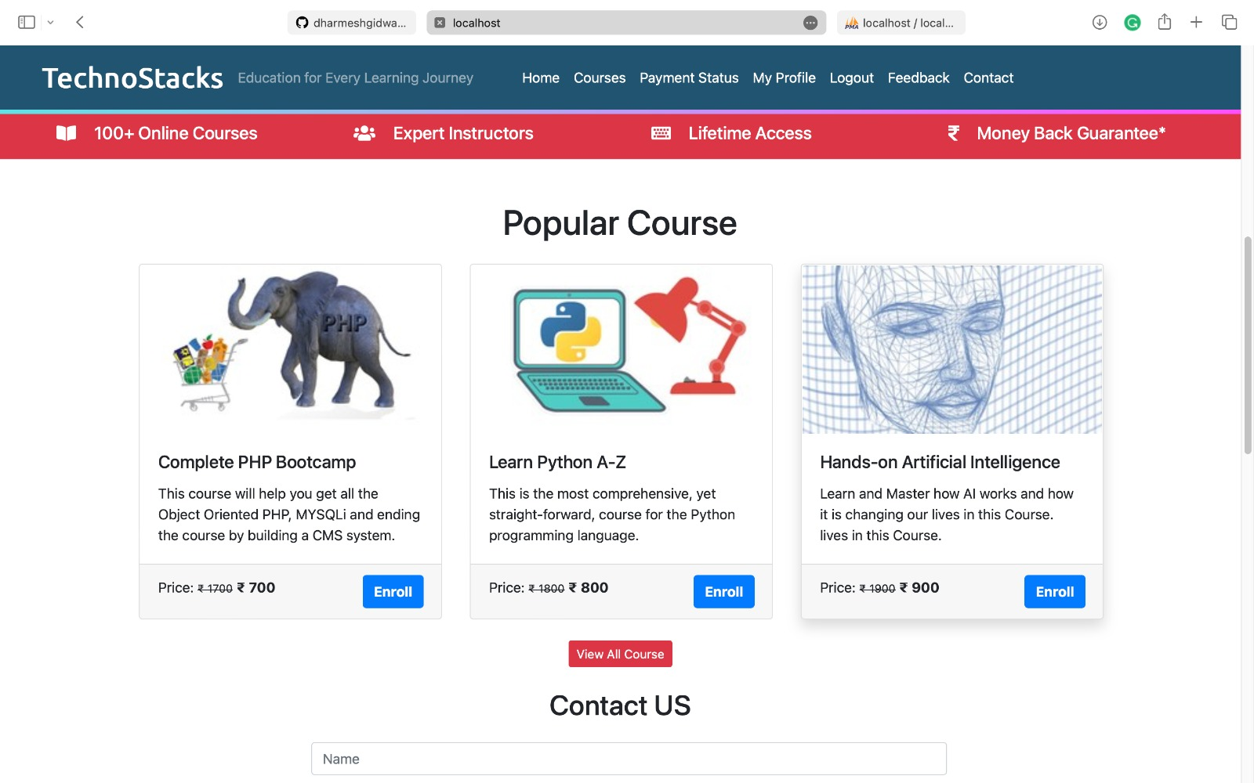

Slide 7
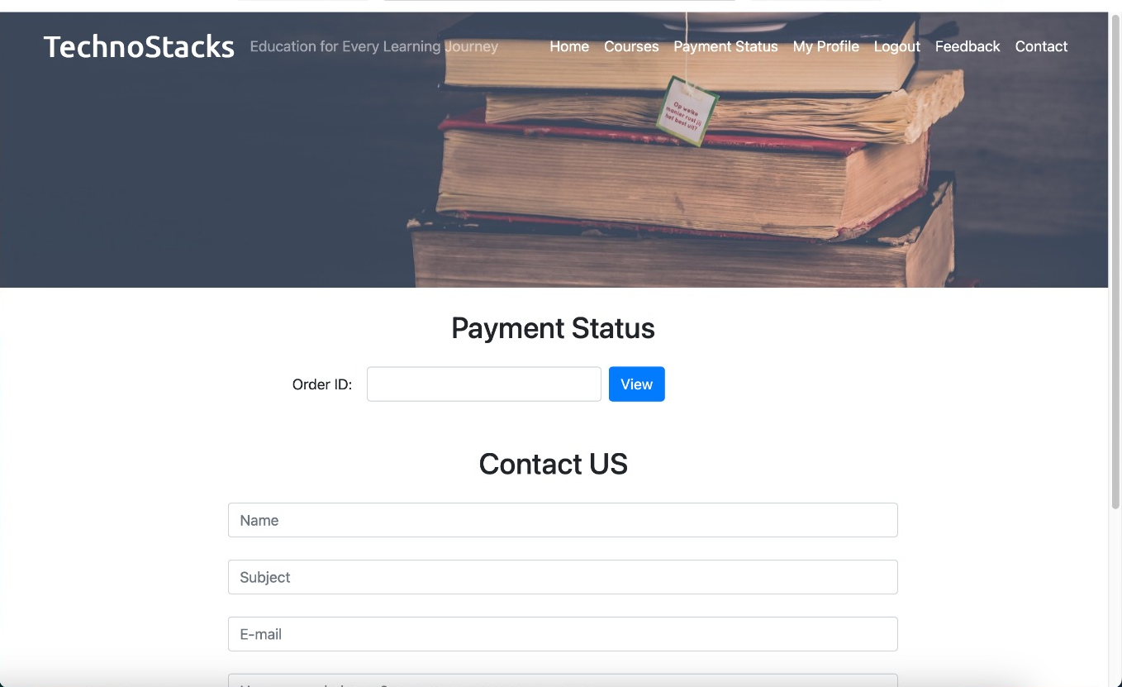

Slide 8
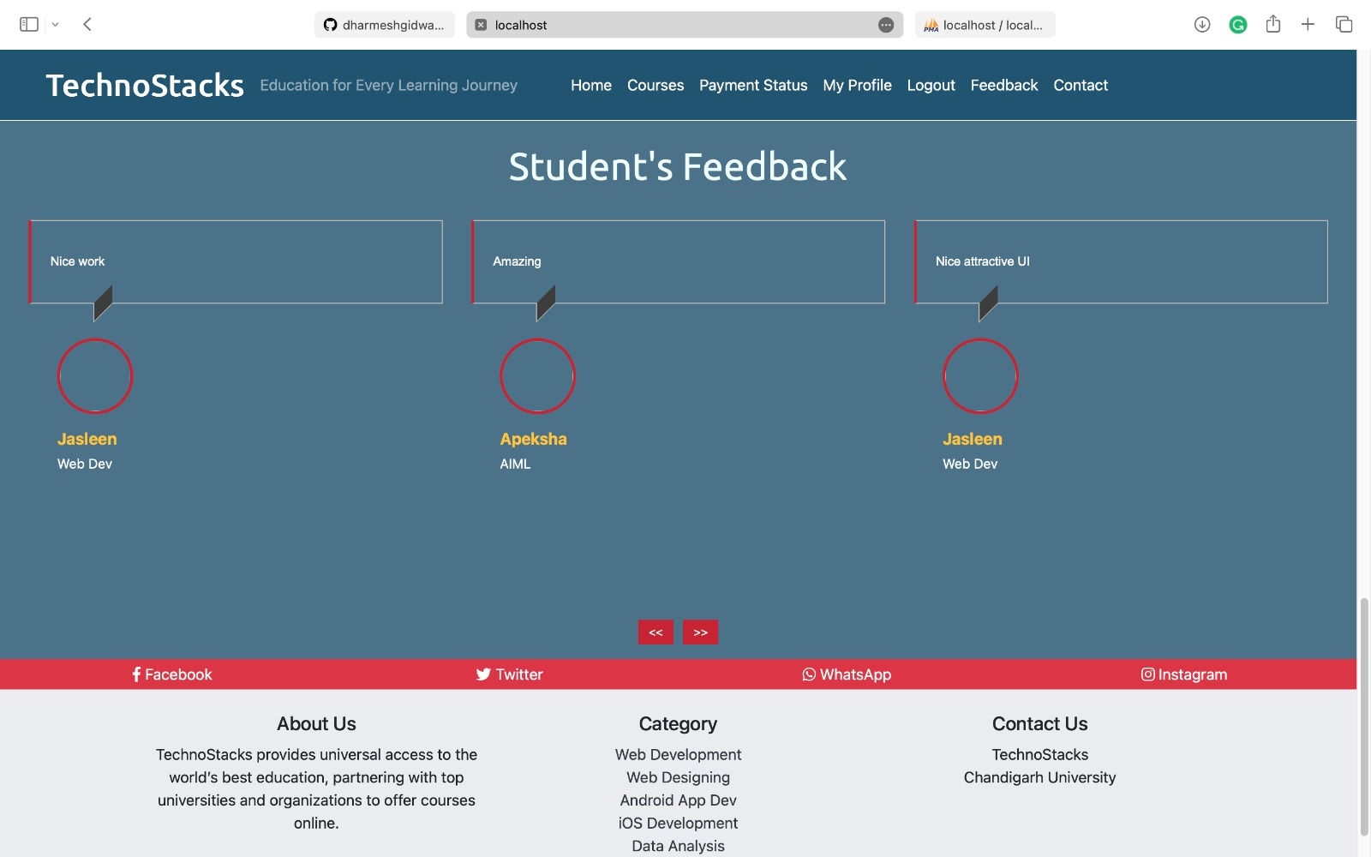

Slide 9
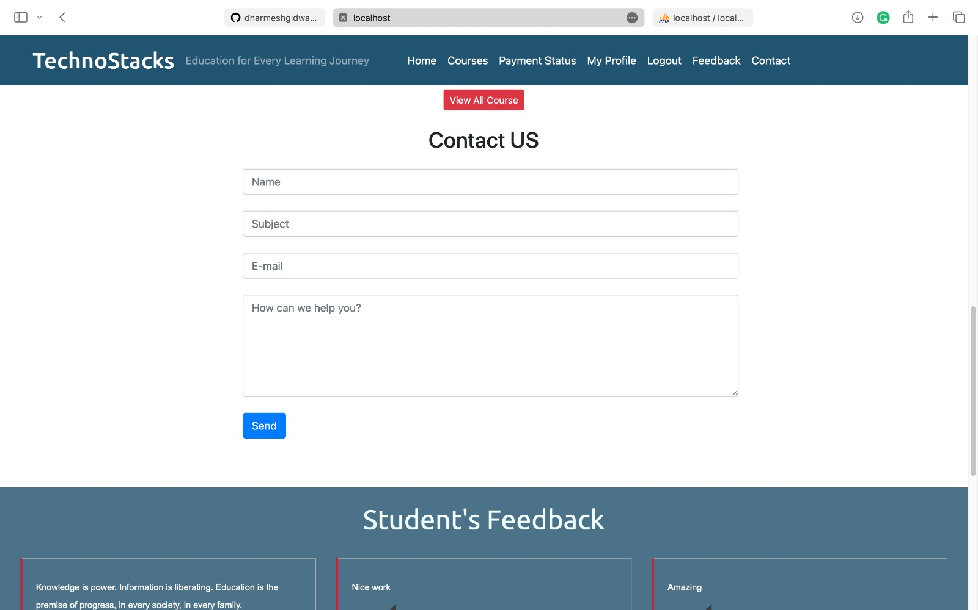

Slide 10
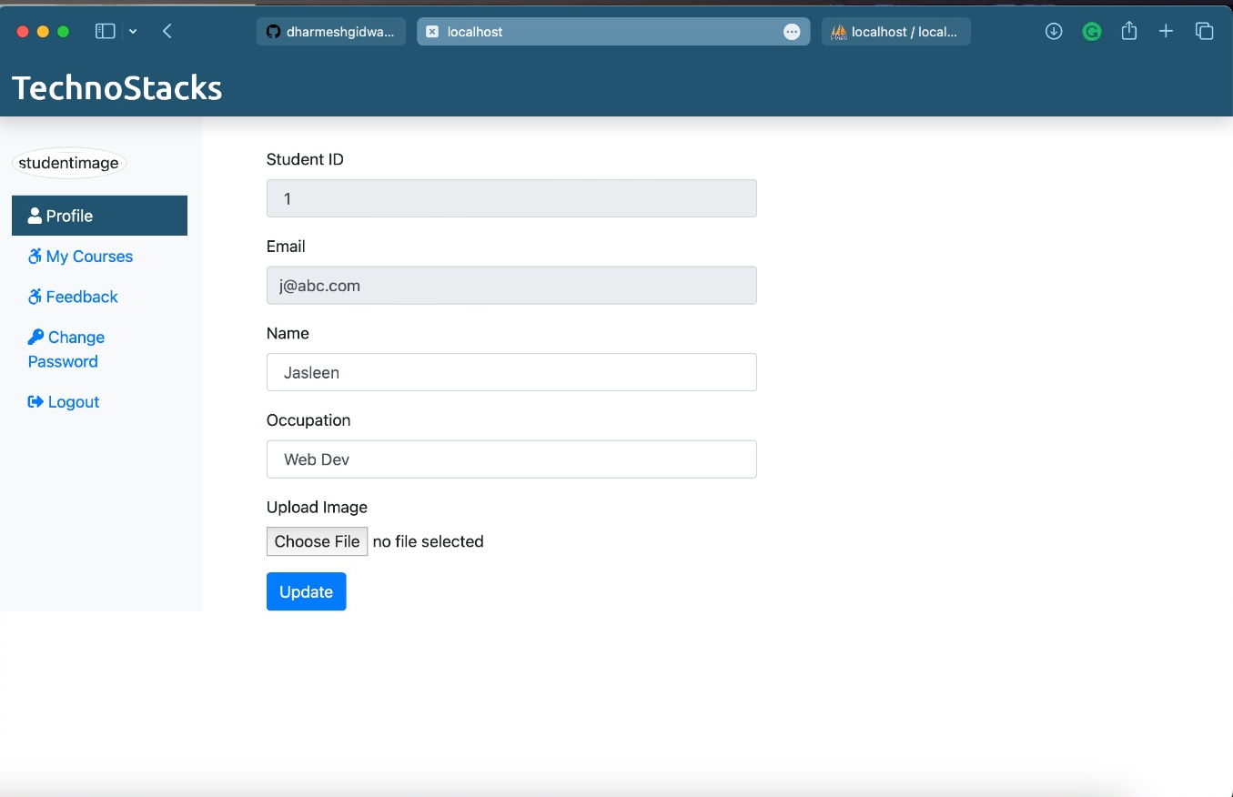

Slide 11
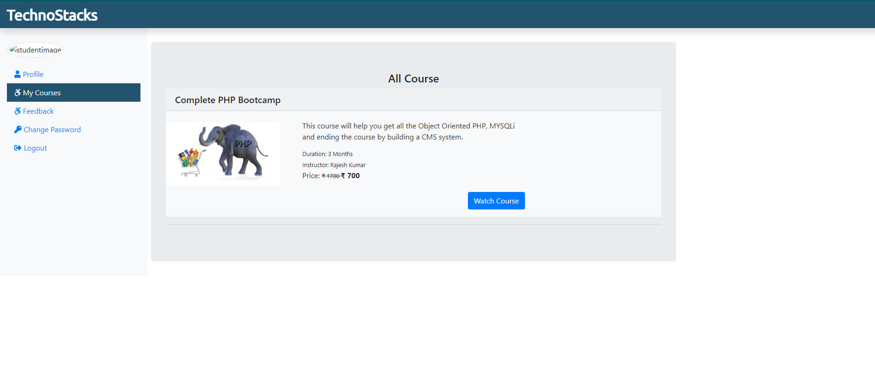

Slide 12
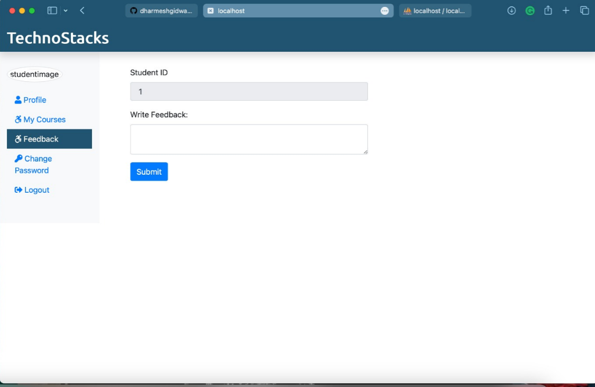

Slide 13
Teacher/Admin Side Website

Slide 14
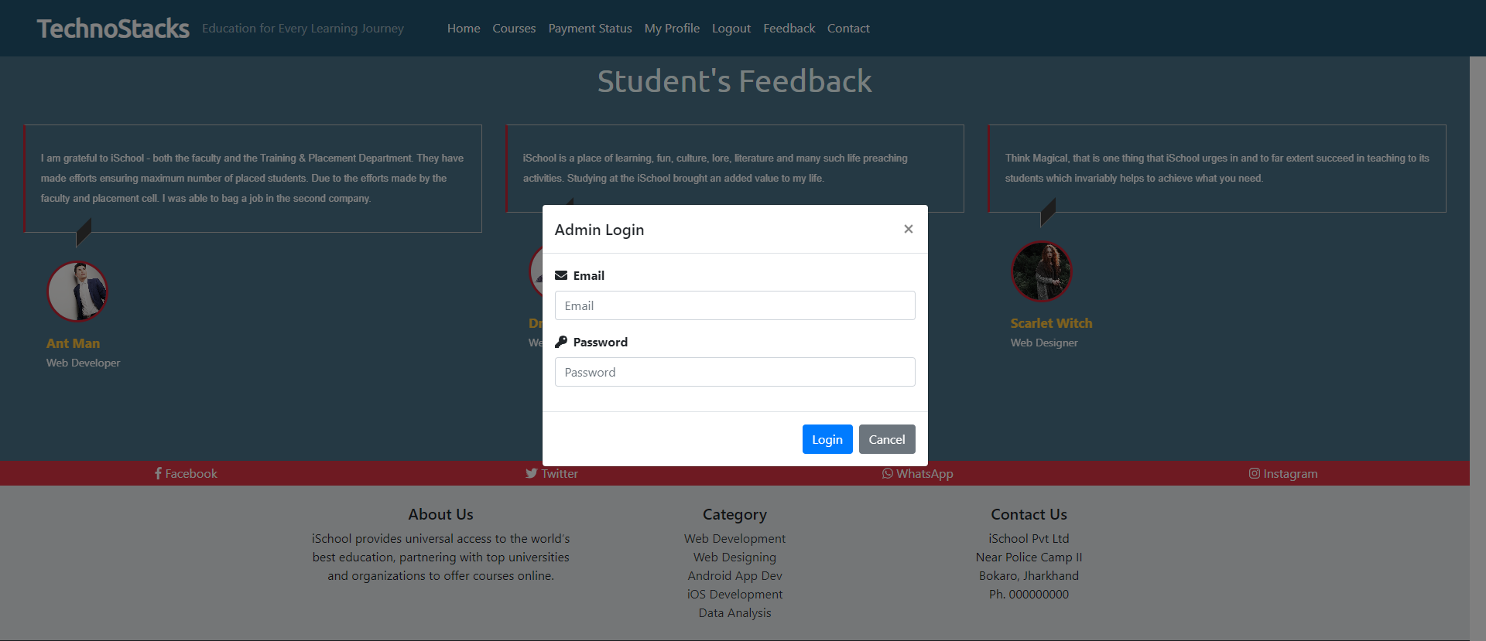

Slide 15
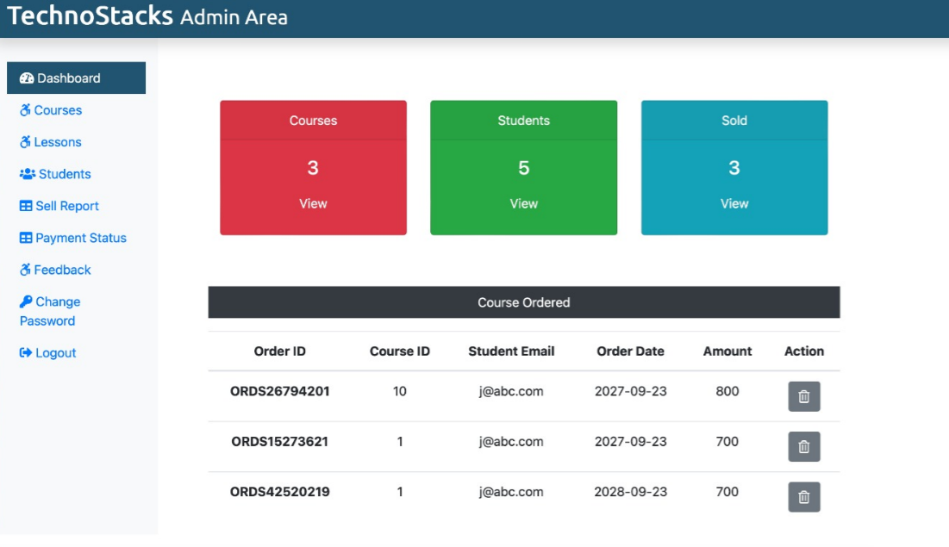

Slide 16
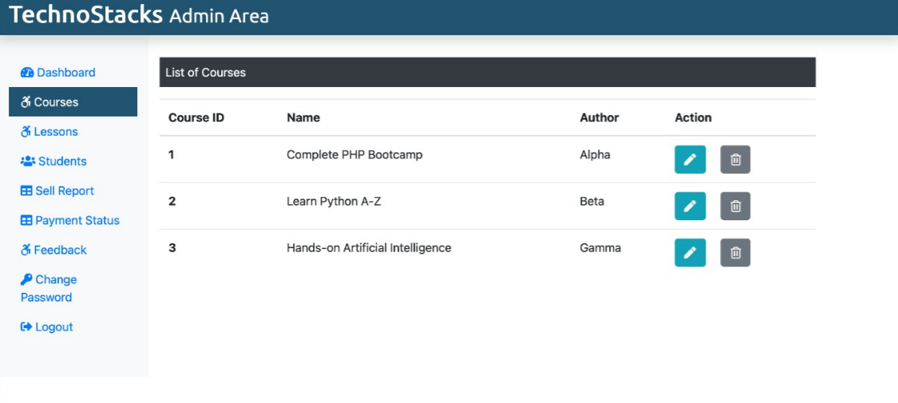

Slide 17
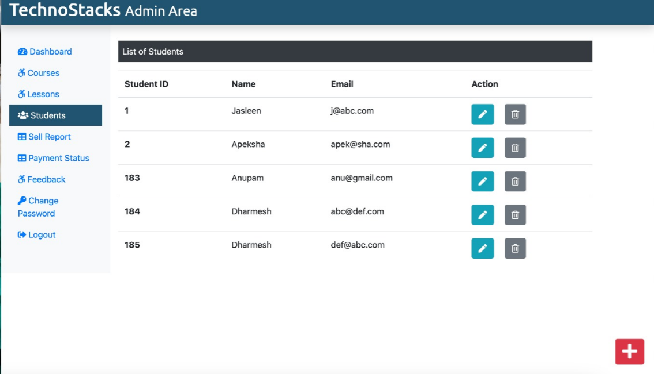

Slide 18
